Slide 1

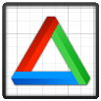


pyCGM2
Btk
OpenMA
Scientifical python packages
Core : Python 2.7

Slide 2
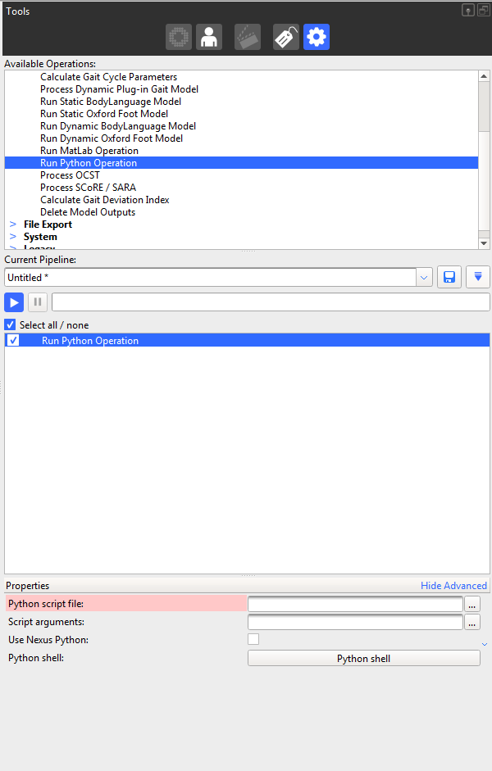
1. Double click on « Run Python Operation »
Add an operation
You can rename by a single click on
2. Add python file from pyCGM2/Apps
3. Add input arguments
Leave unticked this checkBox,

Slide 4
Static Trial
Gait Trial 1
Gait Trial 2
call
optional
RECONSTRUCT
RECONSTRUCT
Option : Calibration
New C3d - Kinematics only
(optional)
Static angle profile
New C3d
(optional)
Gait Plots

